Slide 1
Making sense of a variable but structured world
Dave Kleinschmidt // Rutgers Psychology & Cog. Sci.
EnTIRE Seminar Series // Dec 8 2020
Notes:
Hello! I'm a professor of psychology and cognitive science at rutgers new brunswick...
So today I’m hoping to give you a sense of the flavor of problems I work on and to introduce some of the conceptual tools that I’ve found to be useful.
I work mostly on perception, but if there’s a single thing I want you to take away from my talk today it’s that PERCEPTION is often really actually about LEARNING and MEMORY, and we can think about all three of these as forms of inference under uncertainty at different levels.

Slide 2
Perception is hard
Sensory input is noisy and ambiguous
Perception is probabilistic inference
But statistics that support inference change across situations and tasks
Notes:
trivial observation.
It's commonly recognized that…. This means that we can treat perception as probabilistic inference.
Now, what's less commonly recognized is that this inference relies on statistical properties of teh sensory world, adn these statistics _chagne_ from one situation or task to the next.
Makes perception even harder.
what do I mean by this? common recognized: input is noisy. less commonly recognized: statisics that let us infer from noisy input change based on environment or task

Slide 3

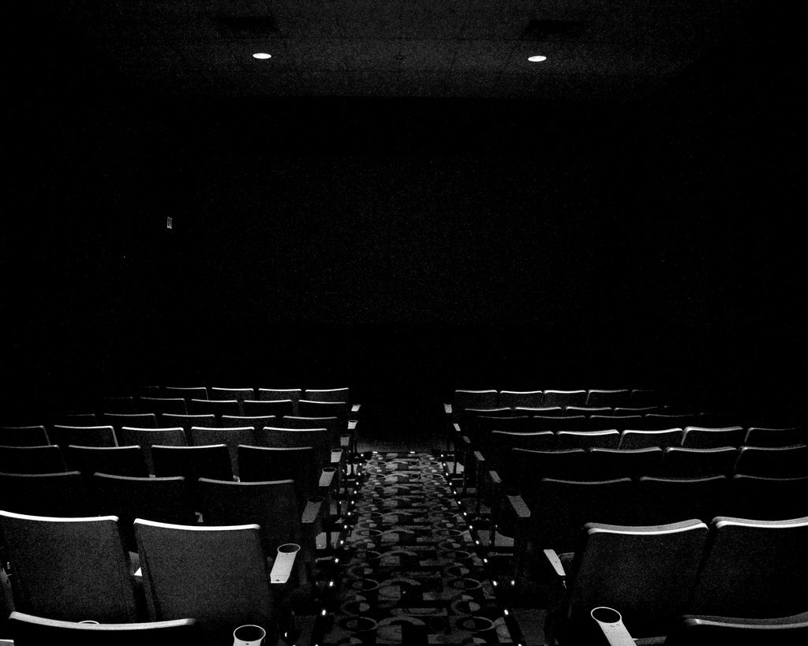
Notes:
when you walk out of a dark theater in the bright sunlight, your visual system has to adjust to the dramatically different light level.

Slide 4
[Webster & MacLeod, 2011]
Notes:
and this isn’t just a low-level thing! for instance, we see exactly the same kind of gain adjustment on highly abstract “face spaces”…

Slide 5
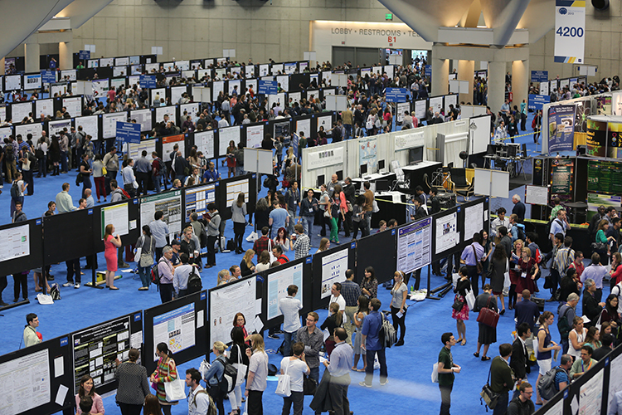



Notes:
and in a busy poster session, you might be listening to someone with a german accent one minute, and someone with a japanese accent the next. your speech perception system deals with the such extreme variability in accents and dialects with remarkable ease.

Slide 6

Notes:
and this isn’t just about changes in the bottom-up signal. the kind of bottom-up information that is even relevant are very different if you’re trying to cross the street, or hail a taxi, or find a particular place to eat.

Slide 7
INFORMATION
‘The cat runs away from the dog’
SIGNAL
Uncertain
Variable
Notes:
...but it's important to keep in mind that the issues I'll talk abou twith speech are really a special case of a very general problem in language comprehension and in cognition as a whole: that you need to make sense out of noisy, variable signals in order to extract meaningful information about the world. what makes this a hard problem?

Slide 8
Spectral center of gravity (COG)
[Newman, Clouse, and Burnham, 2001]
Notes:
phonetic catgories are distributions of cues.

Slide 9

It’s inference under uncertainty

Slide 10
Likelihood
p(cue | category)
Posterior
p(category | cue)
Notes:
EXPLAIN CLASS FUNCTION. but this is okay! as long as we know the cue distribution for each category, we can take any particular cue value, compare how likely it is under either distribution, and convert that into a probability of “sip” or “ship”.

Slide 11
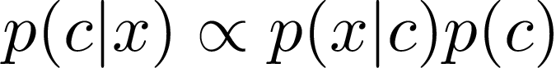
Inference under uncertainty
Accurate inference requires good predictions*
Start with uncertain beliefs (prior; c = /s/ or /sh/?)
Generate predictions about the data you expect based on those beliefs (likelihood)
Update beliefs to reduce prediction error (posterior)
Notes:
this tells us how to deal with this kind of variability that’s just “noise”...
note that I’m talking about a kind of hypothetical prediction here - what data should I expect IF this is true? or that? - not the ability to predict what ACTUALLY happens (although that helps of course)
as an example of how this can be a problem, consider a second kind of variability

Slide 12
IAF
GGG
[Newman, Clouse, and Burnham, 2001]
Notes:
Speech also demonstrates another important problem for perception: cue distributions vary from one situation to the next. ( EXPLAIN FIGURE ).
If you use the wrong generative model, you’re going to get into trouble.
In general, hard problem. BUT: here’s a thing that is very clear in speech: the variation isn’t completely arbitrary. In this case, it’s conditioned on talker identity. This kind of structure makes dealing with variability much easier.
The other complicating factor is what’s known as the “lack of invariance”, or the fact that the mapping from cues to categories CHANGES depending on who’s talking. Two things to note here. You can see here that there’s a lot of variability bETWEEN talkers, too. This is a particularly extreme case, where IAF’s “sip” is physically indistinguishable from GGG’s “ship” on this cue. This kind of variability means that there’s often quite a bit of uncertainty about what the right generative model is in any given situation, and so you need to be tracking the cue distributions. The other thing to note is that this variability isn’t totally random: it’s conditioned on who is talking. That is, there’s a lot of structure there. I’ll come back to that in a bit.
For now, what matters is that you don’t know the generative model with any certainty, and this basically torpedos the ideal listener: how can you do accurate inference if you don’t know the generative model?

Slide 13
Coping with variation
Listeners rapidly adapt to accented speech
With just a few minutes of exposure, comprehension gets much better [Clarke and Garrett, 2004]
How do people adjust category boundaries so fast?
Notes:
two examples of

Slide 14
Distributional learning!!

Slide 15
Distributional learning
Try to reduce prediction error for the data you've seen
Makes your predictions better in the future
...and inferences more accurate
Notes:
let's look at hwo this works in a few cases

Slide 16
distributional learning for
ambiguous /b/
/b/
/d/
low probability =
high prediction error
higher probability =
lower prediction error
Notes:
(focus on prediction error here

Slide 17
distributional learning for
prototypical /b/
high probability =
still some prediction error!
higher probability =
lower prediction error
Notes:
[ qualitative predictions: negative aftereffect ]

Slide 18
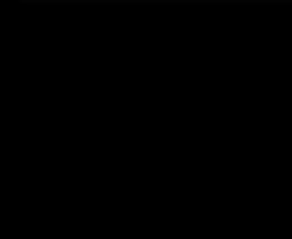
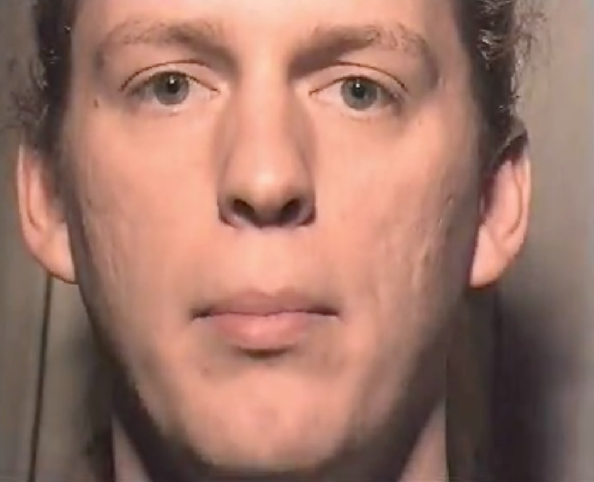
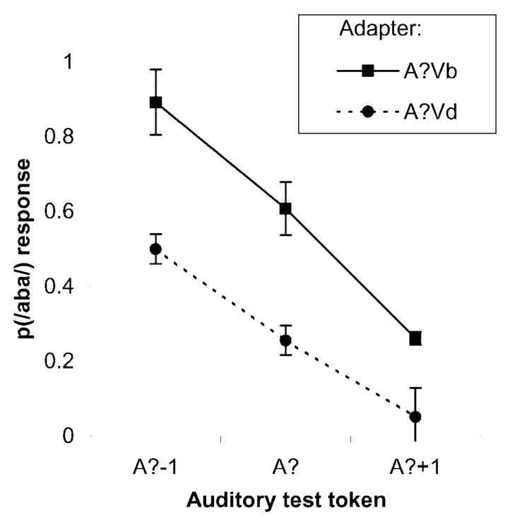
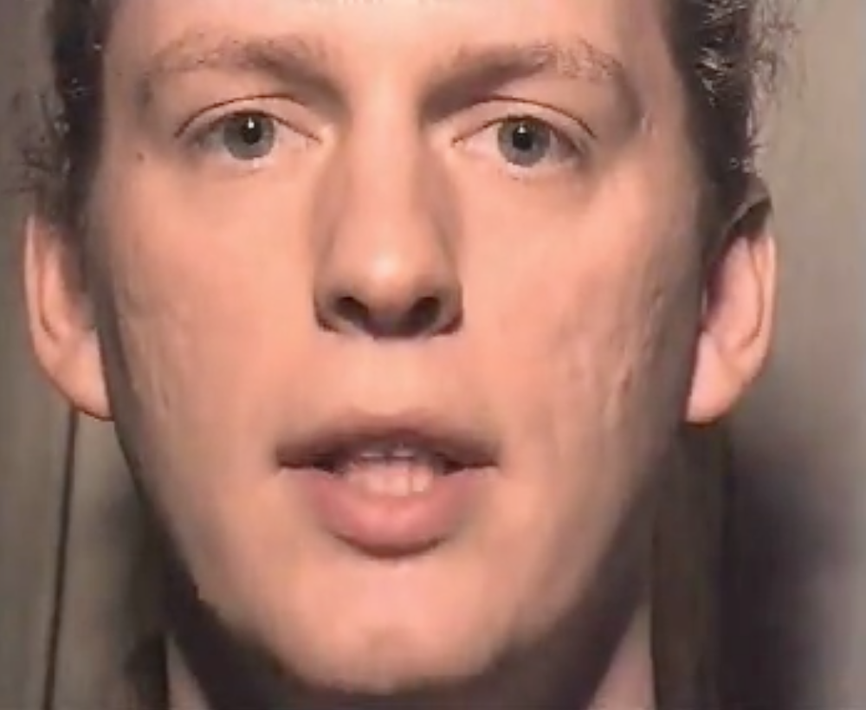

Recalibration
Ambiguous cue
+
Visual Label
= Boundary shift
Vb
A?
/b/
/d/
/aba/ to /ada/
acoustic continuum
Vd
Notes:
(( could cut this slide ))

Slide 19
Model of recalibration [Data: Vroomen et al. 2007; Model: Kleinschmidt & Jaeger 2015]
r² = 0.93
Notes:
Fit them together very well. Two things to note: one of these is recalibration one is selective adaptation, typically thought to be very different mechanisms (learning vs. neural fatigue). also decay in recalibration has puzzled people. but it just falls out of belief updating.
R^2 = 0.93 overall and 0.85 for each individually

Slide 20
But what is distributional learning?
Notes:
so this provides a good account of the behavior, but I promised you more, I promised you true undersatnding. and that requires going a bit deeper, beyond the mechanism of distributional learning. and it might surprise you to find that, if you look just under the surface...

Slide 21
It’s ALL inference under uncertainty

Slide 22
But what is distributional learning?
Infer categories and generative model
(e.g. category means/variances)
posterior (updated)
beliefs
likelihood
prior beliefs
Notes:
these equations can look intimidating but really they're not so scary: reduce prediction error, two ways (category and dist)

Slide 23
Where do you get the prior?
Notes:
...now we’re really getting to the heart of things...

Slide 24
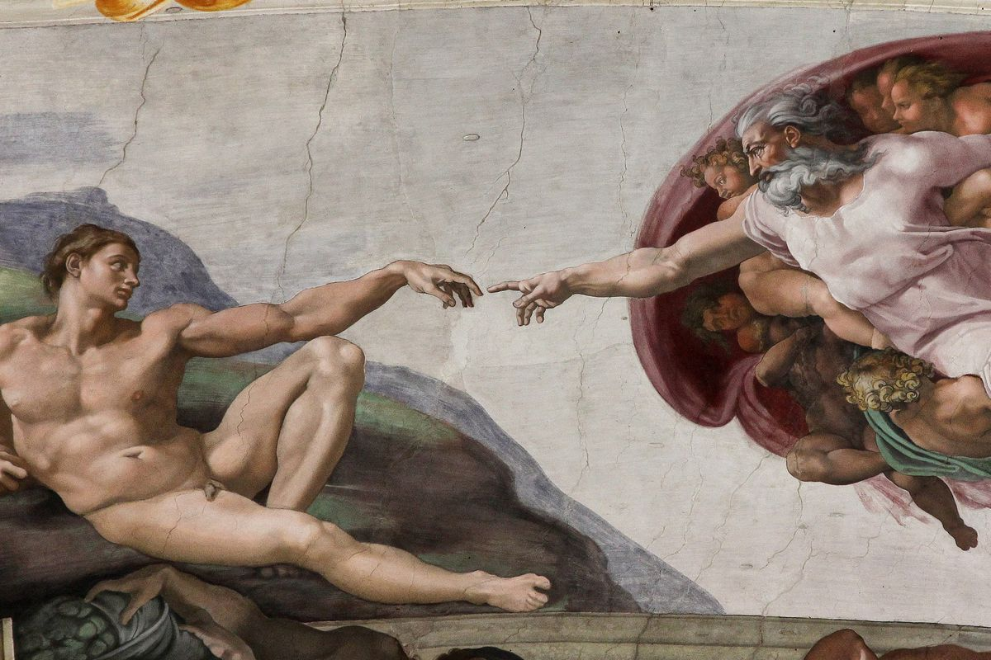
Distributional learning!!
...at another level

Slide 25
Where do you get the prior?
Prior is a prediction
Utility of prediction depends on distribution of things in the world
Predict things you never get: inefficient (takes longer to adapt)
Rule out things you do get: can't adapt
Good prior depends on learning those distributions (of distributions)
Notes:
now this is where things get really interesting, because the appropriate prior also depends on the context

Slide 26
Observations
Parameters
*
Notes:
each talker's generative model is a point in "generative model space". you can think of this as a space where ach dimension is a parameter of the generative model. Now, distribtuion in this space is a _prediction_ about what kind of distributions you expect to encounter. let's take a step back and think about what kinds of predictions we'd make, as omniscient oracles

Slide 27
Observations
Parameters
Notes:
in the absence of any particular expectations...
when you go into a situation where you’re ready for weird stuff to happen, like a phonetics experiment, you should consider basically any kind of generative model that’s at all reasonable. this way you be maximally flexible and make the best use of the data you get.
but critically, you don’t consider EVERYTHING...there are constraints based on your prior experience

Slide 28
Observations
Parameters
Notes:
each situation calls for a different set of prior beliefs: if you know you're going to encounter a familiar talker, your prior beliefs should reflect your previous experience with them.

Slide 29
Observations
Parameters
Notes:
…Or, if you know you're talking to a female, you can use your experience with other female talkers, and teh range of generative models they use, to narrow down the range of generative models you consider

Slide 30
How relevant is prior experience in this context?
Not very
Adapt
Kinda
Generalize
Totally relevant
Recognize
Notes:
(( make point about inferring type of current talker as well as what types exist in the world: higher-level distributional learning ))
what this means is that, your predictions (and hence prior) should be conditional on the type of talker. if this is right, the brain doesn’t just keep one generative model around that it constantly tunes (unlike all other models of adaptation). Rather, you’re doing two things: first, they have to be inferring what prior experience is relevant in each situation (type of talker is part of posterior). second, they have to be distributional learning all these different distributions for different types of talkers as they go. this is akin to the sort of thing that people have proposed for phonetic category learning, but instead of learning distributions of cues, I’m suggesting that listeners should be learning distributions of generative models.

Slide 31
How relevant is prior experience in this context?
Not very
Kinda
Totally relevant
Adapt
Generalize
Recognize
Perceptual learning/Recalibration
[e.g., Bertelson et al. 2003; Norris et al. 2003; Maye, Aslin, & Tanenhaus, 2008]
Selective adaptation*
[e.g., Eimas and Corbit, 1973; Samuel 1986]
Language-level prior
[e.g., Idemaru & Holt, 2011; Schertz et al., 2016; Kleinschmidt in revision]
Top down cues (gender, dialect, accent)
[e.g. Hay & Drager, 2010; B. Munson 2011, Niedzielski, 1999; Staum Casasanto, 2008; Strand & Johnson, 1996]
Accent adaptation
[e.g., Bradlow & Bent, 2008; Baese-Berk et al. 2013]
Generalization of recalibration
[e.g., Kraljic & Samuel 2005, 2007; C. Munson, 2011; Reinisch & Holt, 2013]
Talker-specificity
[e.g. Goldinger; Nygaard; Pisoni; Sumner; many others]
Persistent adaptation
[e.g., Eisner & McQueen, 2006; Kraljic & Samuel 2005]
[Kleinschmidt & Jaeger, 2015, Psych. Review]
Notes:
Unifies this huge, disparate literature.
evidence that people are doing this kind of inference, too.
two examples:
infer new groups of talkers
hold onto recalibration
So far, I’ve focused on how listeners can cope with talker variability by learning directly from the speech they observe. But I want to come back to this question of leveraging prior experience, because this can make coping with talker variability much easier. When you don’t have a lot of relevant prior experience, you start off with pretty vague prior beliefs. You’re ready for just about anything, but the downside is you need more evidence to zero in on the right generative model. But you often do have relevant prior experience, like with your mother’s speech. In these cases, once you’ve recognized that talker, your prior experience tells you everything you need to know. Of course, to be able to take advantage of prior experience, you need to be constantly inferring how the current talker fits into the space of other talkers you’ve met before. I’m not going to get into this right now, but one of the really cool things about this perspecitve is that you can treat this as a form of inference as well. And just by thinking about speech perception this way, we can get a unified view on a whole range of phenomena that people have observed.
If we zoom out a ways, just thinking about adaptation to talker variability as a process of inference under uncertainty ties together the superficially dissimilar strategies that listeners use to cope with this variability. I think the simplest way of organizing this is by asking “how relevant is prior experience for the listener right now?” When prior experience isn’t very relevant, like a totally novel talker, ideal adapter predicts more reliance on current experience, and rapid adaptation. At the other extreme are situations like a highly familiar talker. “just by recognizing who the talker is, your prior beliefs tell you everything you need to know”. And of course there are intermediate cases, where you have experience with similar talkers. In this case, generalizing from your experience with similar talkers gives you a big head start in adaptation. I’m not going to get into it now, but you can treat this process of deciding which prior beliefs are appropriate as a third level of inference, inference of who the talker is. I’ll just say that there’s abundant empirical validation, and that they do them more or less in a way that agrees with the major predictions of the ideal adapter.

Slide 32
Prior is a prediction
What should listeners predict?
Depends on amount and structure of talker variability that they experience
What do listeners predict?
What kind of variation can listeners adapt to?

Slide 33
Prior beliefs constrain adaptation
Expose to different accents (n = 138 on MTurk):
“beach”
“peach”
[Based on Clayards et al. 2008; Kleinschmidt in revision]
Notes:
ongoing work that even when you’re rapidly adapting to a new talker, prior experience matters
prediction is this: if you encounter a talker whose accent is way outside the normal range of variation, your prior is going to be hard to overcome.
to test this, …
before I move on, briefly mention some ongoing work about the role that your prior beliefs play. prediction: accelerate adaptation to talkers when they line up with prior beliefs, but constrain adaptation to talkers that fall outside.
each accent differs just in the distribution of voice onset time, an important cue in distinguishing words like “beach” and “peach”. we know that people pick up on this distributional information, and learn that the lower cluster corresponds to words like “beach” and the higher one to words like “peach”.
…can use this to actually infer what peoples prior beliefs are. this is just two categories, and one cue, but we can scale it up pretty easily with crowdsourced data.

Slide 34
Prior beliefs constrain adaptation
Predict classification curves
…and compare with behavior
[Based on Clayards et al. 2008; Kleinschmidt in revision]
Notes:
and based on these distributions, we can predict what the optimal classification function would be. you can see that some of these distributions differ quite a bit from what a typical talker produces. we asked people to say whether they heard “beach” or “peach” on each trial, and compared their responses to the ideal classification curves. You can see that their category boundaries are all pretty much in between what the predictions for perfect learning, and for a typical talker.
…can use this to actually infer what peoples prior beliefs are. this is just two categories, and one cue, but we can scale it up pretty easily with crowdsourced data.

Slide 35
Looking ahead
Computational level:
What inductive biases make learning about contexts tractable?
What is the structure of variability in the world?
Algorithmic level:
How do we manage uncertainty with finite resources?
Implementation level:
How, where, and when is distributional learning done in the brain?

Slide 36
What is a context?
Are people looking for (and finding) changes in context?
What is the structure of variability across contexts?
Within talkers
Across talkers
Across parts of the phonetic space
DISTRIBUTIONAL
LEARNING!!
(just kidding)
Notes:
here's where just saying that everything is distributional learning starts to feel like it's coming up a bit short. because this learning problem is SO vast, it starts to matter a lot more what you think the inductive biases are...what kind of structure are people looking for? what kind of structure actually exists in the world?
not to say that we've reached the end of the usefulness of rational analysis, far from it. rather, it highlights how much thinking about the scope and the in-principle nature of the problem
because people are looking for structure!

Slide 37
Looking for contexts: spatial recall
People take advantage of statistical contingencies to enhance memory [Roediger & McDermott 1995; DuBrow et al. 2017; Huttenlocher et al. 1991; Orhan and Jacobs, 2013; Brady & Tenenbaum, 2013]
What about when the statistical contingencies change?
Immediate spatial recall task with multiple uncued clusters

Slide 38
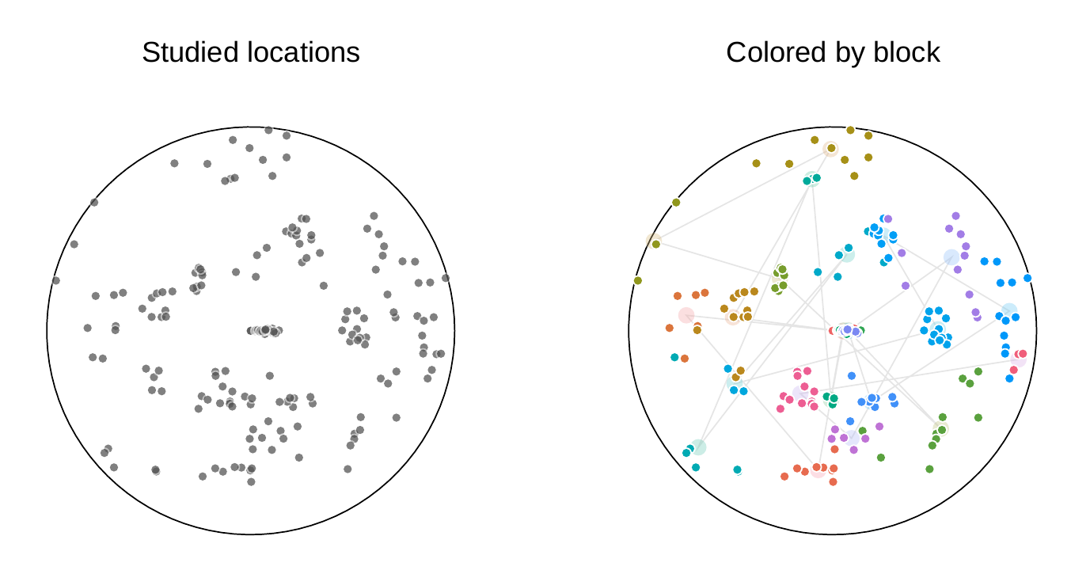
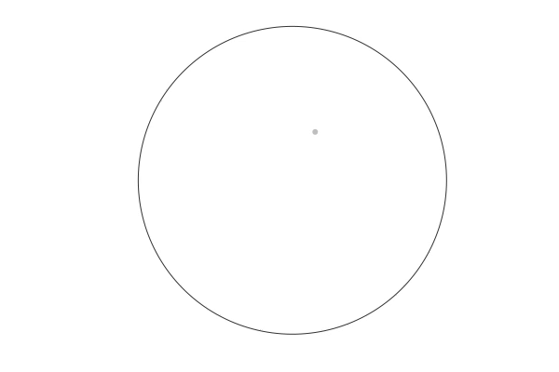
Looking for contexts: task
[Robbins, Hemmer, & Tang, 2014]
Immediate recal of location (with mask and distractor task)

Slide 39
Looking for contexts: model
[Kleinschmidt & Hemmer, 2019]
Model infers clusters via Bayesian non-parametric clustering
“Sticky” Dirichlet process prior
Prefer to cluster similar observations together
Recalled location combines noisy memory trace with inferred cluster

Slide 40
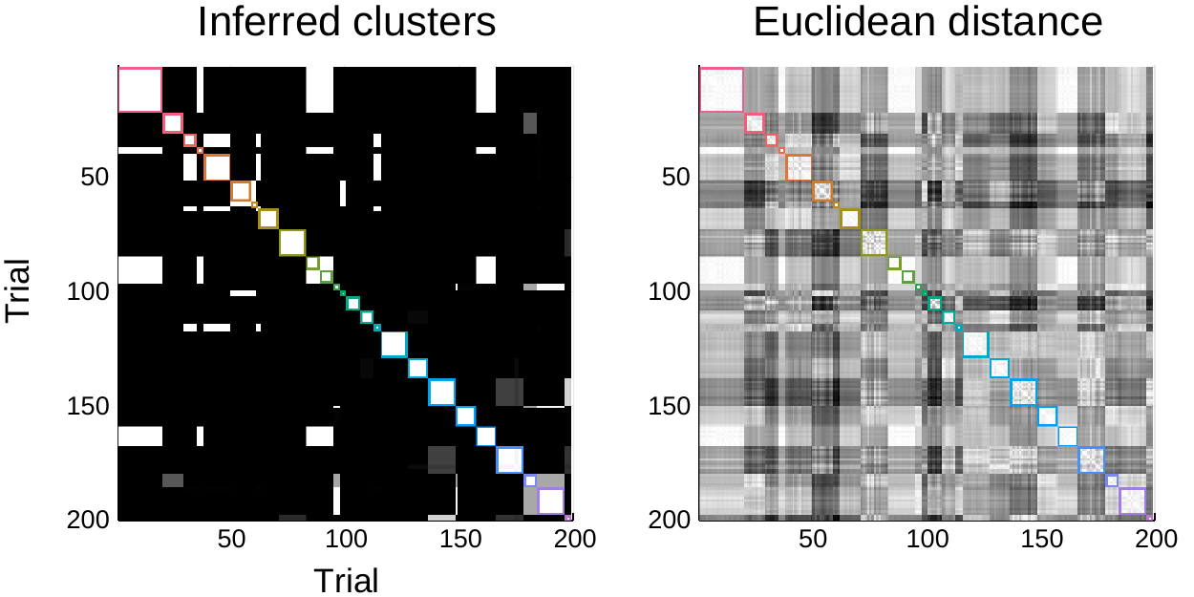
Looking for contexts: inferred contexts
Inferred cluster assignment similarity
True clusters

Slide 41
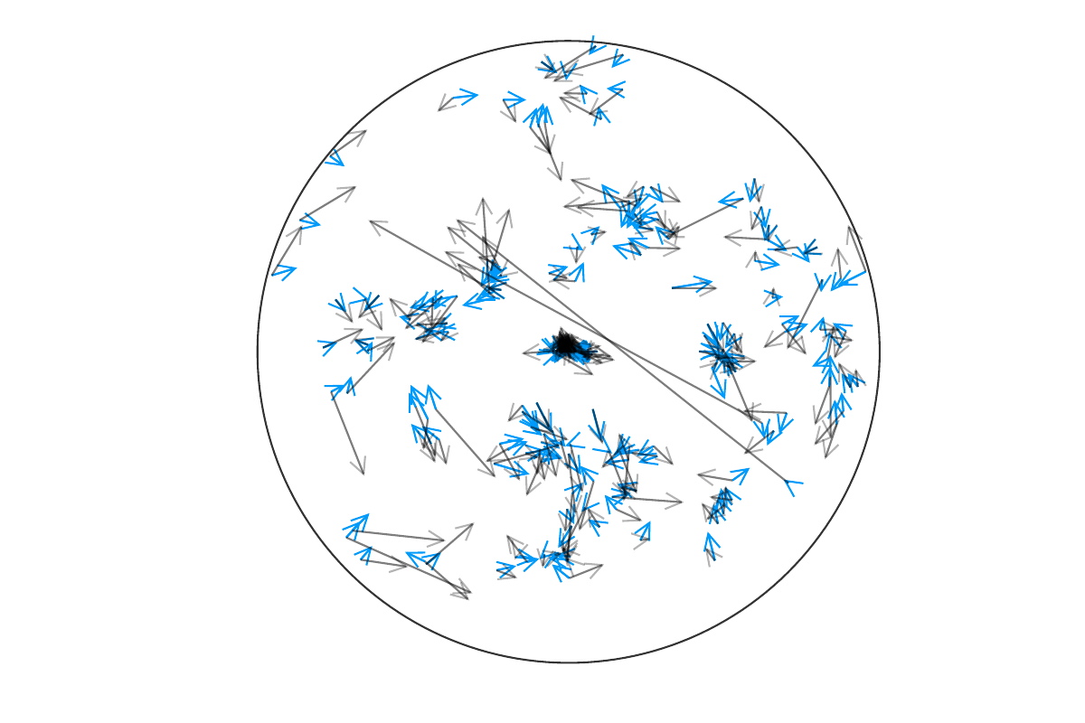
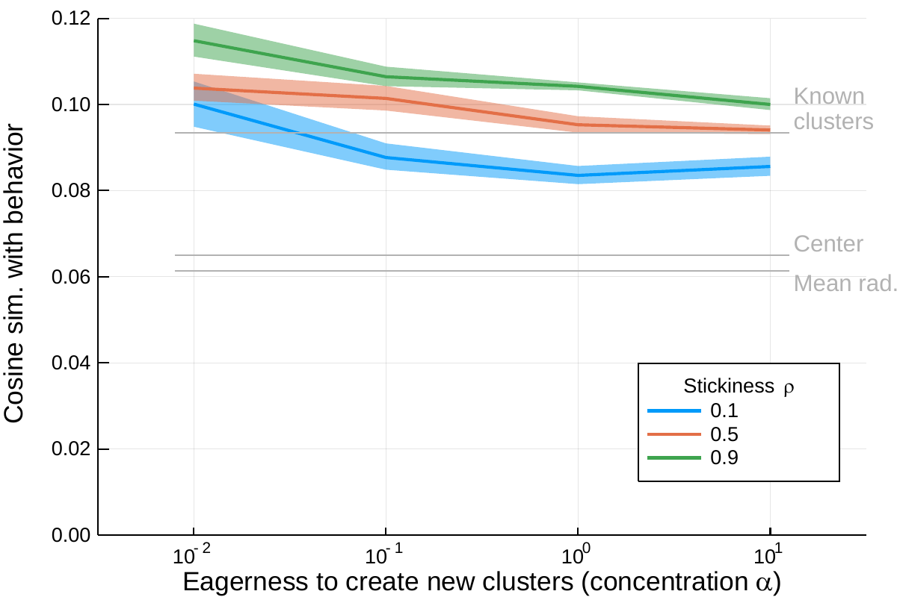
Looking for contexts: behavior vs. model

Slide 42
Looking for contexts
People act like they're looking for changes in context
And use context-specific statistics to guide recall

Slide 43
Effective inference in a variable world requires inference at multiple levels:
About stimuli (cues)
About distributions (accents)
About contexts (type of talker)

